Slide 1
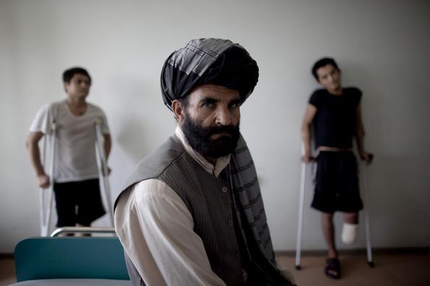
MEDICAL SOCIAL WORK
IMRAN AHMAD SAJID, PhD

Slide 2
Aka
Health Care Social Work, or
Hospital Social Work

Slide 3
Medical Social Work is a branch of social work that deals with the social, physical and psychological aspects of patient.
~Paul Chaudry~

Slide 4
Medical Social Work provides case work, after-care and convalescence* services to the needy and poor patients and thereby
cut returns to hospitals,
prevent spread of disease and breakdown in patient’s family,
make medical treatment more meaningful and effective,
undertake rehabilitation of the patients, and
activate community action for the benefit of patients.
~Pakistan’s First Five Year Plan, 1955-60~
* to spend time recovering from an illness or the effects of medical treatment, especially by resting

Slide 5
Background
A century ago, medical treatment was thought to be the only alternative of bodily or mental derangement.
But this assumption has undergone a radical change after the scientific progress and the growth of social sciences.
Now the fact has been revealed that disease of a patient involves two principal aspects, namely:
Like medical treatment, the psycho-social condition of a patient is also very important.
Therefore, improvement in the mental condition of a patient is very essential for the amelioration of illness.
As a result of this recognition, the need for social worker has been realized in the field of medical practice.
M. Khalid
Patient’s Disease
Physiological
Psycho-Social

Slide 6
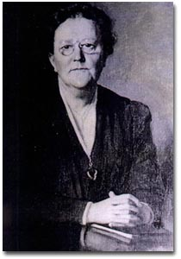
History
Dr. Richard Cabot --very sensitive to the relationship between disease and poverty.
some patients after having medication got satisfied and became healthy but, some patients remained ill even of the same disease and same medication.
So he realized that there is not just the physical factors responsible for the disease and treatment-but the patients need some social treatment as well.
Dr. Richard Cabot in 1905 --brought Ida Cannon to the Massachusetts General Hospital in Boston, USA.
Ida Cannon --convinced that medical practice could not be effective without examining the link between illness and the social conditions of the patient
Ida Cannon

Slide 7
Assumptions of MSW
Health refers to that state or condition, in which an individual is capable to utilize all the capacities of his social living.
The treatment is not the final solution for illness.
Disease and diseased person are different from each other.
Physician studies the disease. Medical social work studies the diseased person, i.e. the social aspect of the disease.

Slide 8
Objectives of MSW in Pakistan
To provide help and assistance to the patients in their psychological, social and economic problems through the process of case work.
To provide blood-testing and blood-transfusion services to the poor patients.
To supply free-of-cost medicine to the poor and deserted patients.
To assist the hospital administration as well as the voluntary organizations in the hours of misfortune.

Slide 9
In Pakistan, Medical Social Workers receive funds for these objectives from Zakat and Bait-ul-Maal.

Slide 10
Role of Medical Social Worker
In Pakistan, Medial Social Worker is known as Social Medical Officer in hospitals. He/she provides following services:-
Counseling services
interpreting the meaning of illness and disease;
giving necessary health guidance, knowledge about sanitation, health care etc.
giving needed information to patient’s families regarding their care and treatment during convalescence
Notes:
giving information and facts about the disease and thereby removing any misconception they may have about the disease and its effects

Slide 11
providing needed facilities and guidance to drug addicts during their treatment in hospitals or as out door patients
Discharge Planning
Management, administration, and planning functions
Group Work Services

Slide 12
Q/A

